Slide 1

Divide and Conquer
Presented by:
Elizer Ponio Jr.
Department of Computer Science
College of Computing and Information Technologies

Slide 2
Outline
Divide and Conquer Approach

Slide 3
Divide and Conquer Approach
Divide
Conquer
Combine
Divide the given problem into sub-problems using recursion.
Solve the smaller sub-problems recursively. If the subproblem is small enough, then solve it directly.
Combine the solutions of the sub-problems that are part of the recursive process to solve the actual problem.

Slide 4

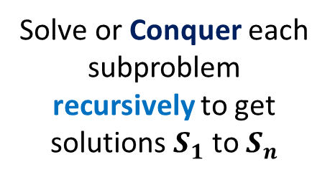

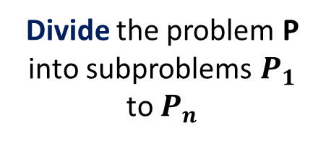







Divide and Conquer Approach
Given problem P
P
Divide the problem P into subproblems $P_{1}$ to $P_{n}$
$$P_{1}$$
$$P_{2}$$
$$P_{3}$$
…
$$P_{n}$$
Solve or Conquer each subproblem recursively to get solutions $S_{1}$ to $S_{n}$
…
$$S_{1}$$
$$S_{2}$$
$$S_{3}$$
$$S_{n}$$
S
Combine solutions $S_{1}$ to $S_{n}$

Slide 5
Divide and Conquer Approach
Divide
Conquer
Combine
Divide the given problem into sub-problems using recursion.
Solve the smaller sub-problems recursively. If the subproblem is small enough, then solve it directly.
Combine the solutions of the sub-problems that are part of the recursive process to solve the actual problem.
In the divide and conquer approach, recursion is used.

Slide 6
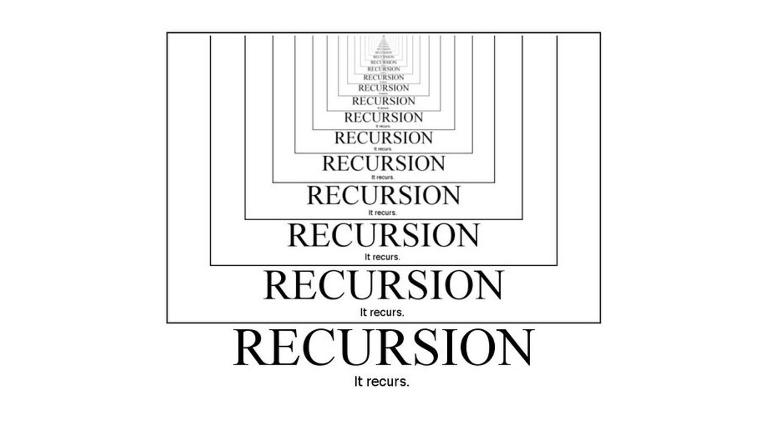
Recursion
In programming, a method that calls itself is known as a recursive method. And, this process is known as recursion.

Slide 7
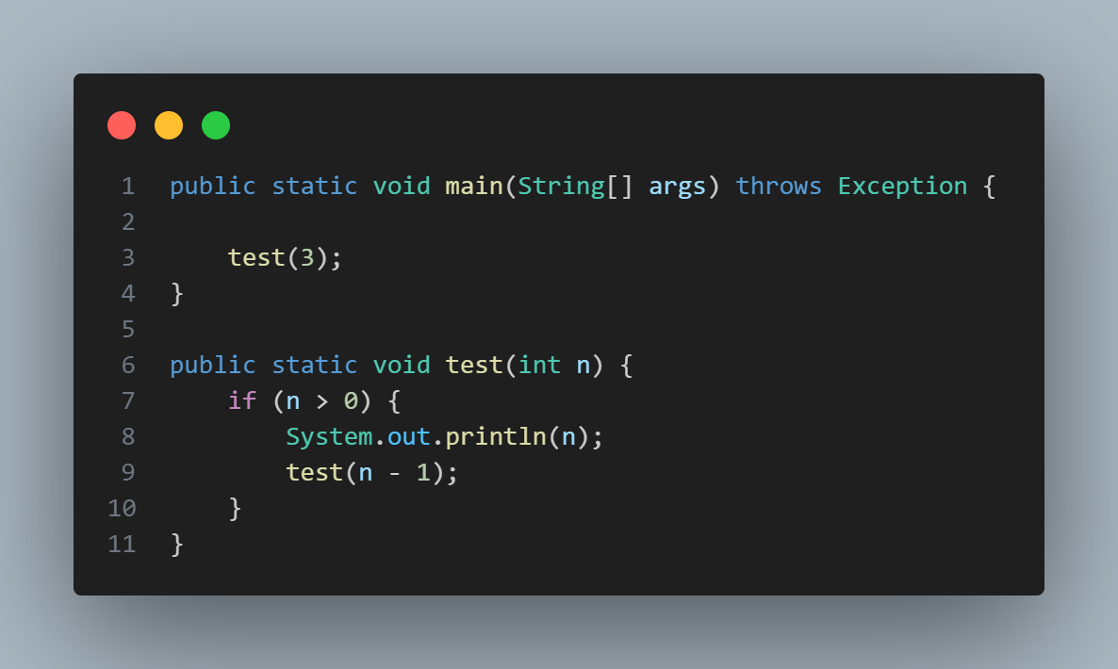
Normal method call
Recursive call

Slide 8

test(3)
3
$$\text{t}\text{est}\text{(}\text{2}\text{)}$$
2
test(1)
1
test(0)

Slide 9
Recurrence Relation
Recurrence relations describe the running times of recursive algorithms

Slide 10


$$1$$
$$T(n−1)$$

Slide 11
$$1$$
$$T(n−1)$$

Slide 12









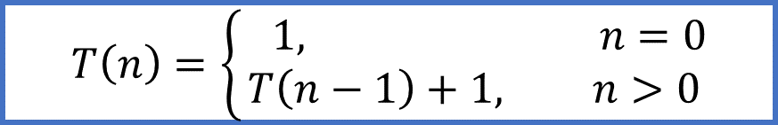


Recurrence Relation
$$T\left(n\right)=\left\{\begin{aligned} 1, n=0 \\ &T\left(n−1\right)+1, n>0\end{aligned}\right.$$
$T\left(n\right)=T(n−1)$ + 1
$T\left(n−1\right)=T(n−2)$ + 1
$T\left(n−2\right)=T(n−3)$ + 1
Substitute $T(n−1)$
$T\left(n\right)=T(n−1)$ + 1
$T\left(n\right)=[ T\left(n−2\right)+1$ ] + 1
$$T\left(n\right)= T\left(n−2\right)+2$$
$T\left(n\right)=[T\left(n−3\right)+1]$ + 2
$T\left(n\right)=T\left(n−3\right)$ + 3
$$…$$
$T\left(n\right)=T\left(n−k\right)$ + k

Slide 13


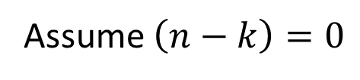
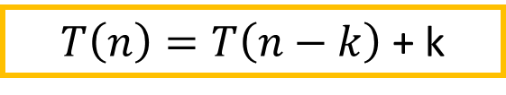

Recurrence Relation
$$T\left(n\right)=\left\{\begin{aligned} 1, n=0 \\ &T\left(n−1\right)+1, n>0\end{aligned}\right.$$
$T\left(n\right)=T\left(n−k\right)$ + k
Assume $\left(n−k\right)=0$
$$T\left(n\right)=T\left(0\right)+n$$
$$T\left(n\right)=1+n$$
$$O(n)$$

Slide 14
References
https://www.programiz.com/dsa/divide-and-conquer

